Slide 1

Blazor in .net 8

Slide 2
Agenda
New Feature
Blazor Web App
Introduction
Render Mode
LifeCycle
PreRender
Webcil packaging

Slide 3
New Features
Feature | Detail | Hosting Support
 |  | Web | WebAssembly | Server(7.0)
Form | AntiforgeryToken | ✔️ | ✔️ | ✔️
 | SupplyParameterFromFormAttribute | ✔️ | ✔️ | ✔️
 | Enhanced form handling | ✔️ | ✔️ | ✔️
DataBinding | Two way binding: @bind:get/set | ✔️ | ✔️ | ✔️
Stream Rendering | StreamRenderingAttribute | ✔️(Server) | ❌ | ❌
Error Page | Default errorpage: /Pages/Error.razor | ✔️ | ❌ | ✔️
Route to named elements | Navigation.NavigateTo("/counter#targetElement"); | ✔️ | ✔️ | ✔️
Webcil packaging | Published with .wasm instead of .dll file | ✔️(WebAssembly) | ✔️ | ❌
Handle errors | Use ComponentBase.DispatchExceptionAsync | ✔️ | ✔️ | ✔️
 | Use IHostEnvironment | ✔️ | ❌ | ✔️
WebAssembly Runtime | Configure the .NET WebAssembly runtime | ✔️(WebAssembly) | ✔️ | ❌
Dialog | Support for dialog cancel and close events | ✔️ | ✔️ | ✔️

Slide 4
New Features
Feature | Detail | Hosting Support
 |  | Web | WebAssembly | Server(7.0)
Quick Grid | Blazor QuickGrid component from .net 7 | ✔️ | ✔️ | ✔️
Render outside asp .net core | Render Razor components outside of ASP.NET Core
Identity UI | generating a full Blazor-based Identity UI | ✔️ | ❌ | ❌

Slide 5
Blazor Web App
Introduction
Render Componment:
Comparing with Blazor Server and Blazor WebAssembly,Blazor Web Apps is a full-stack application mixed with server-side and client-side rendering modes.
https://learn.microsoft.com/en-us/aspnet/core/blazor/components/render-modes?view=aspnetcore-8.0

Slide 6
Blazor Web App
Render Mode
Static render mode
The Static render mode is the default render mode without configure @rendermode and can’t enable interactivity and stream
Server render mode
The Server render mode renders the component interactively from the server using Blazor Server
WebAssembly render mode
The WebAssembly render mode renders the component interactively on the client using Blazor WebAssembly
Auto render mode
The component is initially rendered server-side with interactivity using the Blazor Server hosting model. The .NET runtime and app bundle are downloaded to the client in the background and cached so that they can be used on future visits. Components using the automatic render mode must be built from a separate client project that sets up the Blazor WebAssembly host.

Slide 7
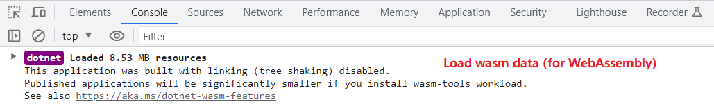
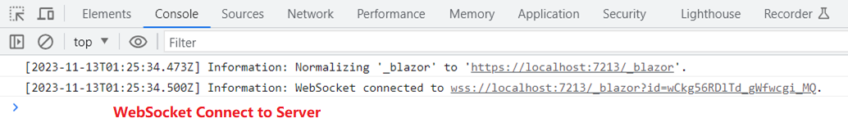
Blazor Web App
Render Mode
Web Assembly
Server

Slide 8
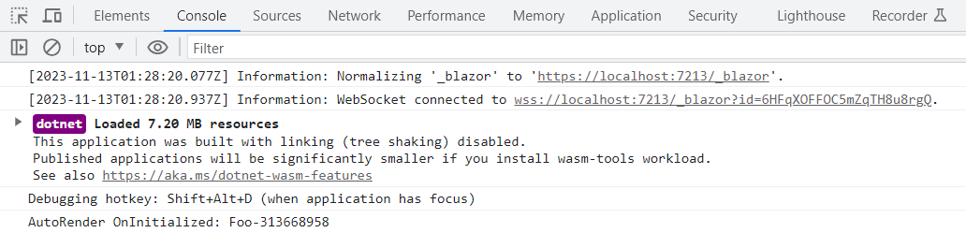
Blazor Web App
Render Mode
Auto

Slide 9
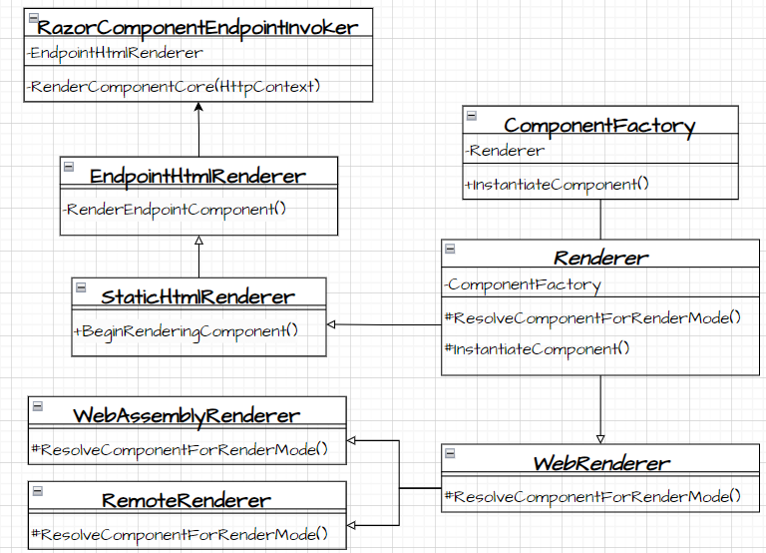
Blazor Web App
Render Mode
Render Componment:
RazorComponentEndpointInvoker.cs
RazorComponentEndpointInvoker.RenderComponentCore()
1. Initialize StreamingRendering Framing
2. Initialize Standard Component Services
3. Render Endpoint Component
3.1 InstantiateComponent
3.1.1 ResolveComponentForRenderMode
3.2 Waiting for quiesence(none stream Rendering) complete
4. write by HttpResponseStreamWriter

Slide 10
Blazor Web App
Render Mode
Render Componment:
RazorComponentEndpointInvoker.cs
RazorComponentEndpointInvoker.RenderComponentCore ->
EndpointHtmlRenderer.InitializeStandardComponentServicesAsync
EndpointHtmlRenderer.RenderEndpointComponent->
BeginRenderingComponent->
ComponentFactory.InstantiateComponent
WaitForResultReady() wait for quiescence of the non-streaming subtrees
EndpointHtmlRenderer.PrerenderPersistedStateAsync ->
return ComponentStateHtmlContent with different PrerenderComponentApplicationStore
Write by HttpResponseStreamWriter

Slide 11
Blazor Web App
Create Component:
ComponentFactory.cs
ComponentFactory.InstantiateComponent
Renderer.ResolveComponentForRenderMode -> override by EndpointHtmlRenderer/WebAssemblyRenderer : WebRenderer / RemoteRenderer : WebRenderer
->IComponentActivator.CreateInstance ->Implement by DefaultComponentActivator
->PrerenderPersistedStateAsync
RazorComponentEndpointInvoker.RenderComponentCore ->
EndpointHtmlRenderer.RenderEndpointComponent->
…-> ComponmentFactory.InstantiateComponent

Slide 12
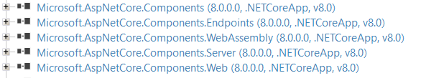
Blazor Web App
Render Mode

Slide 13
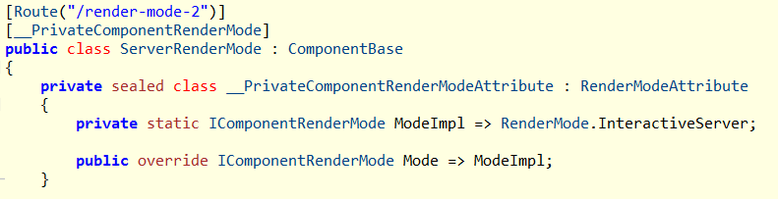
Blazor Web App
Render Mode
Component will generate a private __PrivateComponentRenderModeAttribute which distingulish the RenderMode:
@page "/render-mode-2"
@rendermode RenderMode.InteractiveServer
<h3>Server Render Mode</h3>

Slide 14
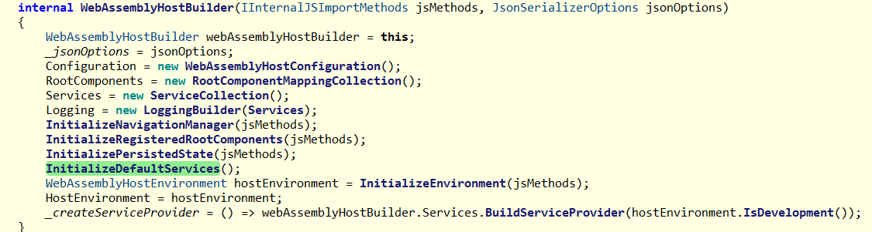
Blazor Web App
WebAssemblyHostBuilder.cs

Slide 15
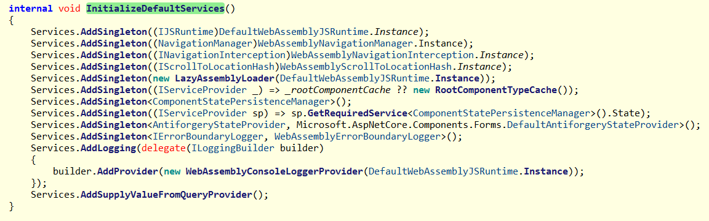
Blazor Web App

Slide 16
WebApplicationBuilder
Blazor.web hosting:
WebApplicationBuilder.Services.AddRazorComponents()

Slide 17
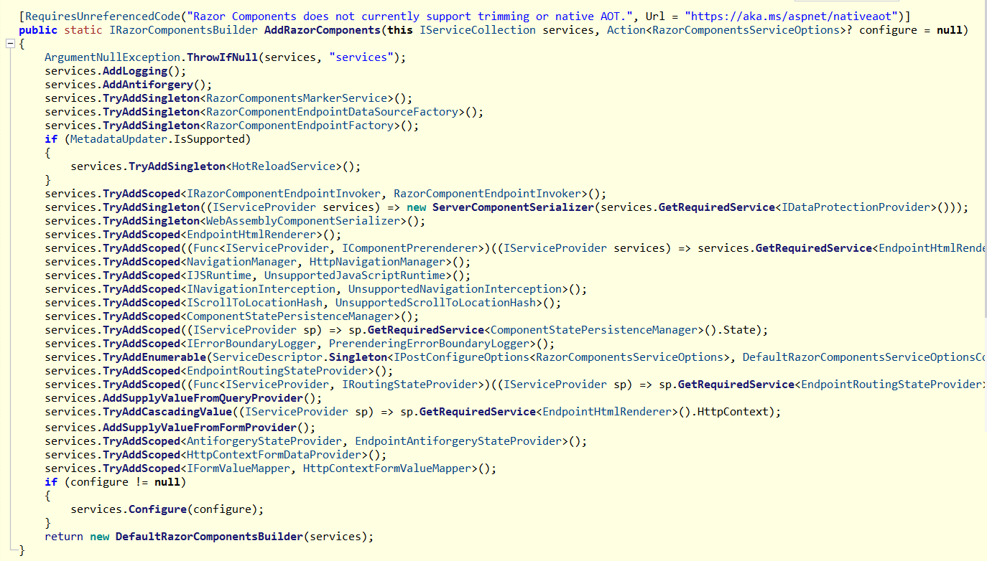

Slide 18
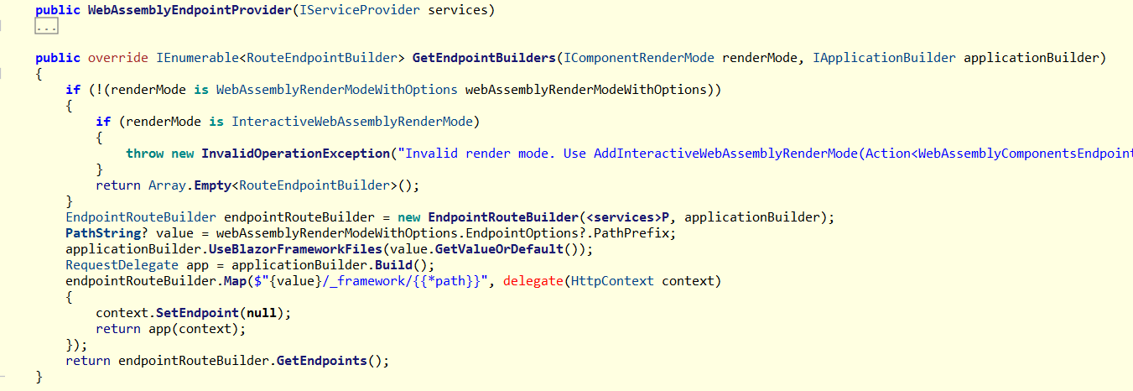
WebApplicationBuilder
AddInteractiveWebAssemblyComponents

Slide 19
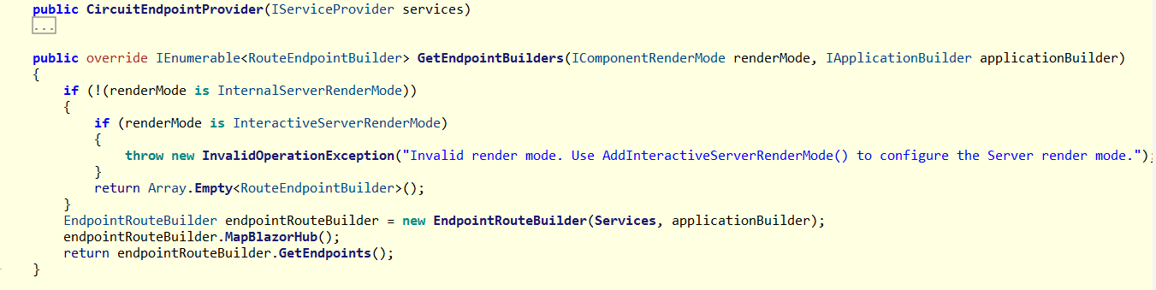
AddInteractiveServerComponents

Slide 20
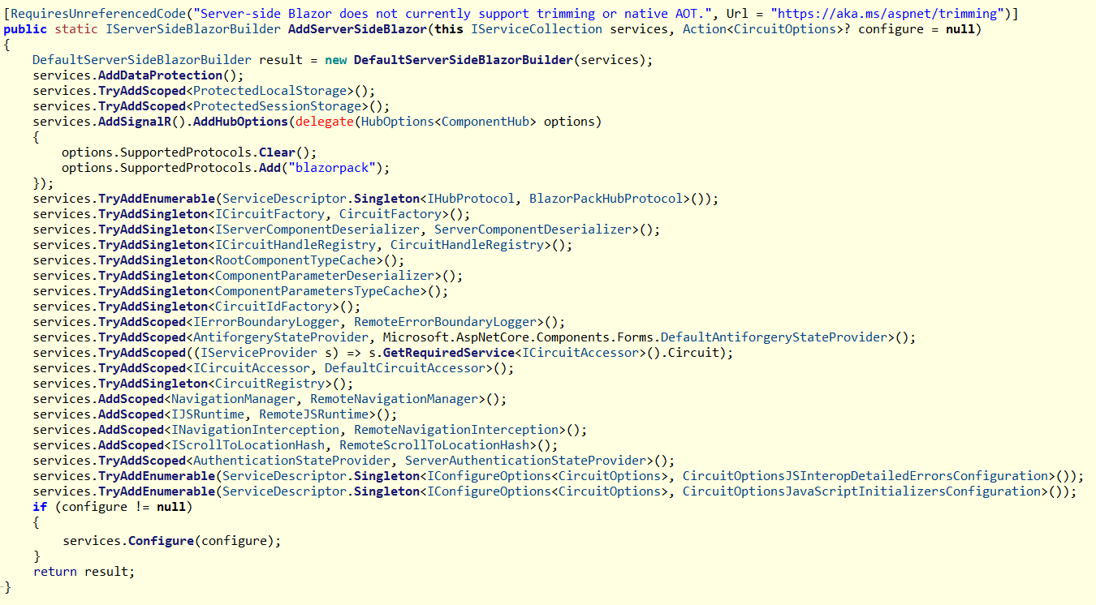

Slide 21
Blazor Web App
Life Cycle
ASP.NET Core Razor component lifecycle
.net 6.0/8.0 Blazor Server/WebAssembly App | .net 8.0 Blazor Web App Server/Wasm/Auto Mode | .net 8.0 Blazor Web App Static Mode
SetParametersAsync - Begin OnInitialized OnInitializedAsync OnParametersSet OnParametersSetAsync SetParametersAsync - End | SetParametersAsync - Begin OnInitialized OnInitializedAsync OnParametersSet OnParametersSetAsync SetParametersAsync – End SetParametersAsync - Begin OnInitialized OnInitializedAsync OnParametersSet OnParametersSetAsync SetParametersAsync – End | SetParametersAsync - Begin OnInitialized OnInitializedAsync OnParametersSet OnParametersSetAsync SetParametersAsync - End
SSR (Server Side Rendering)

Slide 22
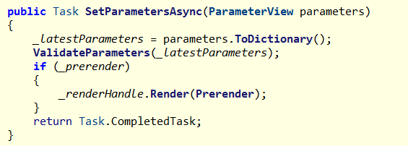
Blazor Web App
PreRender
Blazor apps that prerender their content on the server call SetParametersAsync twice
Prerender at SSRRenderModeBoundary.cs
Set @attribute [RenderModeInteractiveWebAssembly(prerender: false)]/@attribute [RenderModeInteractiveServer(prerender: false)] / @attribute [RenderModeInteractiveAuto(prerender: false)] will disable prerender

Slide 23
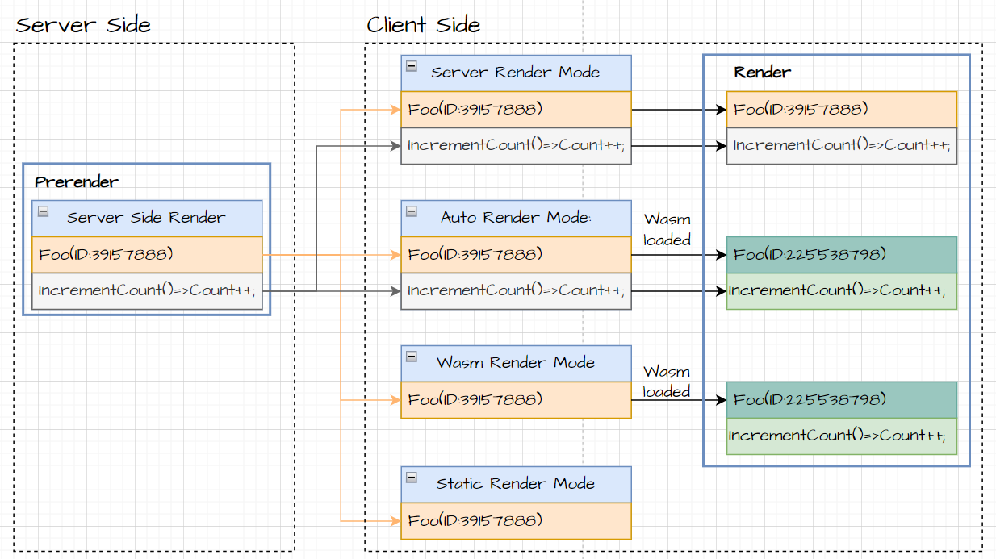
Blazor Web App
PreRender
PreRender enabled and rendering at server side

Slide 24
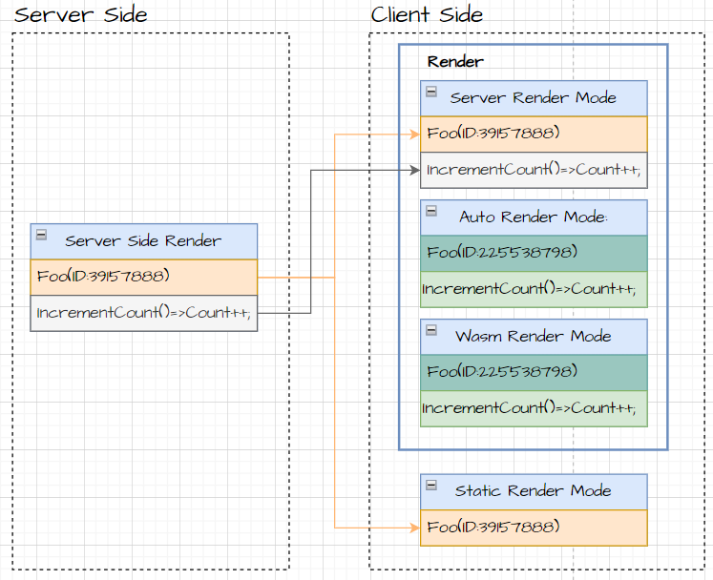
Blazor Web App
PreRender
PreRender Disabled

Slide 25
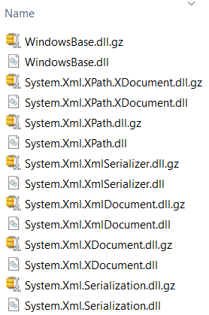
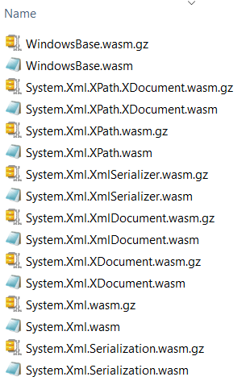
Webcil packaging
Webcil files use a standard WebAssembly wrapper, where the assemblies are deployed as WebAssembly files that use the standard .wasm file extension instead of .dll file.
.net 6.0
.net 8.0

